Slide 1
Expectation Maximization
Gunnvant Saini

Slide 2
Agenda
Gaussian Mixture Models
Overview
Parameters
Prediction
EM algorithm (Clustering)
Algorithm Overview
Example

Slide 3
Gaussian Mixture Models: Overview
v
v

Slide 4
Gaussian Mixture Models: Overview
v
v

Slide 5
Gaussian Mixture Models: Overview
v
v
Each Cluster is a Gaussian

Slide 6
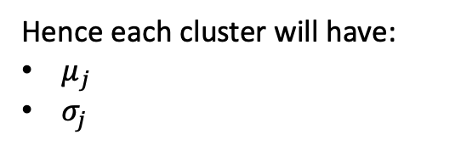
Gaussian Mixture Models: Parameters
Hence each cluster will have:
$μ_{j}$
$σ_{j}$
v
v
Each Cluster is a Gaussian

Slide 7
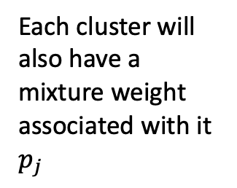
Gaussian Mixture Models: Parameters
Hence each cluster will have:
$μ_{j}$
$σ_{j}$
v
v
Each cluster will also have a mixture weight associated with it $p_{j}$
Each Cluster is a Gaussian

Slide 8

Gaussian Mixture Models: Parameters
Hence each cluster will have:
$μ_{j}$
$σ_{j}$
v
v
Each cluster will also have a mixture weight associated with it $p_{j}$
Each Cluster is a Gaussian
So, parameters are $θ=\{μ_{j},σ_{j},p_{j}\}$

Slide 9
Gaussian Mixture Models: Prediction
Where does this point belong?
Hence each cluster will have:
$μ_{j}$
$σ_{j}$
v
v
Each cluster will also have a mixture weight associated with it $p_{j}$
Each Cluster is a Gaussian
So, parameters are $θ=\{μ_{j},σ_{j},p_{j}\}$

Slide 10

Gaussian Mixture Models: Prediction
Where does this point belong?
$$P\left(x|red\right), P(x|blue)$$
Hence each cluster will have:
$μ_{j}$
$σ_{j}$
v
v
Each cluster will also have a mixture weight associated with it $p_{j}$
Each Cluster is a Gaussian
So, parameters are $θ=\{μ_{j},σ_{j},p_{j}\}$

Slide 11
Gaussian Mixture Models: Prediction
Where does this point belong?
$P\left(x|red\right), P\left(x | blue\right), if P\left(x|red\right)$ > $P\left(x | blue\right)$
Hence each cluster will have:
$μ_{j}$
$σ_{j}$
v
v
Each cluster will also have a mixture weight associated with it $p_{j}$
Each Cluster is a Gaussian
So, parameters are $θ=\{μ_{j},σ_{j},p_{j}\}$

Slide 12
Gaussian Mixture Models: Prediction
Where does this point belong?
$P\left(x|red\right), P\left(x | blue\right), if P\left(x|red\right)$ > $P\left(x | blue\right)$
Hence each cluster will have:
$μ_{j}$
$σ_{j}$
v
v
Each cluster will also have a mixture weight associated with it $p_{j}$
Each Cluster is a Gaussian
So, parameters are $θ=\{μ_{j},σ_{j},p_{j}\}$

Slide 13
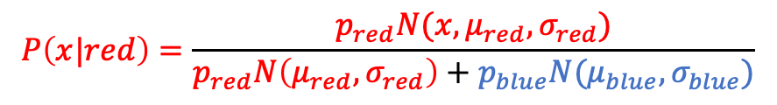
Gaussian Mixture Models: Prediction
Where does this point belong?
$P\left(x|red\right), P\left(x | blue\right), if P\left(x|red\right)$ > $P\left(x | blue\right)$
Hence each cluster will have:
$μ_{j}$
$σ_{j}$
v
v
$$P\left(x|red\right)=\frac{p_{red}N(x,μ_{red},σ_{red})}{p_{red}N\left(μ_{red},σ_{red}\right)+p_{blue}N(μ_{blue},σ_{blue})}$$
Each cluster will also have a mixture weight associated with it $p_{j}$
Each Cluster is a Gaussian
So, parameters are $θ=\{μ_{j},σ_{j},p_{j}\}$

Slide 14

EM Algorithm: Overview
The model’s basic premise is that:
Each cluster will have a mean${ μ}_{j}$ and a sd $σ_{j}$
Also, each cluster will have mixture weights $p_{j}$ associated with them
The task is to estimate parameters $θ=\left\{μ_{j},σ_{j},p_{j}\right\} ∀ j∈[1,k]$

Slide 15
EM Algorithm: Overview
v
v

Slide 16
EM Algorithm: Overview
Randomly select parameters $θ= \{μ_{blue},μ_{red},σ_{blue},σ_{red}, p_{blue},p_{red}\}$
v
v

Slide 17
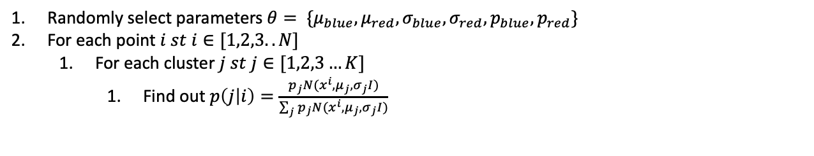
EM Algorithm: Overview
Randomly select parameters $θ= \{μ_{blue},μ_{red},σ_{blue},σ_{red}, p_{blue},p_{red}\}$
For each point $i st i∈[1,2,3..N]$
For each cluster $j st j∈[1,2,3…K]$
Find out $p\left(j | i\right)=\frac{p_{j}N(x^{i},μ_{j},σ_{j}I)}{\sum_{j}{p_{j}N(x^{i},μ_{j},σ_{j}I)}}$
v
v

Slide 18
EM Algorithm: Overview
Randomly select parameters $θ= \{μ_{blue},μ_{red},σ_{blue},σ_{red}, p_{blue},p_{red}\}$
For each point $i st i∈[1,2,3..N]$
For each cluster $j st j∈[1,2,3…K]$
Find out $p\left(j | i\right)=\frac{p_{j}N(x^{i},μ_{j},σ_{j}I)}{\sum_{j}{p_{j}N(x^{i},μ_{j},σ_{j}I)}}$
E Step
v
v

Slide 19
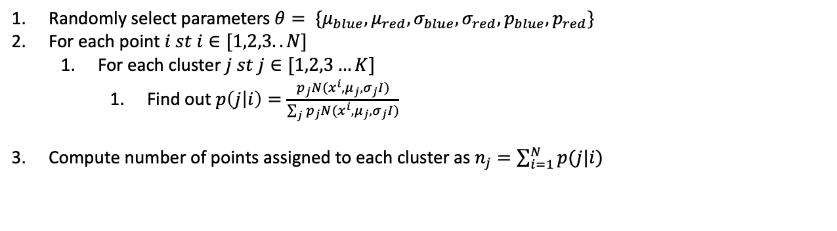
EM Algorithm: Overview
Randomly select parameters $θ= \{μ_{blue},μ_{red},σ_{blue},σ_{red}, p_{blue},p_{red}\}$
For each point $i st i∈[1,2,3..N]$
For each cluster $j st j∈[1,2,3…K]$
Find out $p\left(j | i\right)=\frac{p_{j}N(x^{i},μ_{j},σ_{j}I)}{\sum_{j}{p_{j}N(x^{i},μ_{j},σ_{j}I)}}$
Compute number of points assigned to each cluster as $n_{j}=\sum_{i=1}^{N}{p(j|i)}$
Randomly select parameters $θ= \{μ_{blue},μ_{red},σ_{blue},σ_{red}, p_{blue},p_{red}\}$
For each point $i st i∈[1,2,3..N]$
For each cluster $j st j∈[1,2,3…K]$
Find out $p\left(j | i\right)=\frac{p_{j}N(x^{i},μ_{j},σ_{j}I)}{\sum_{j}{p_{j}N(x^{i},μ_{j},σ_{j}I)}}$
E Step
v
v

Slide 20
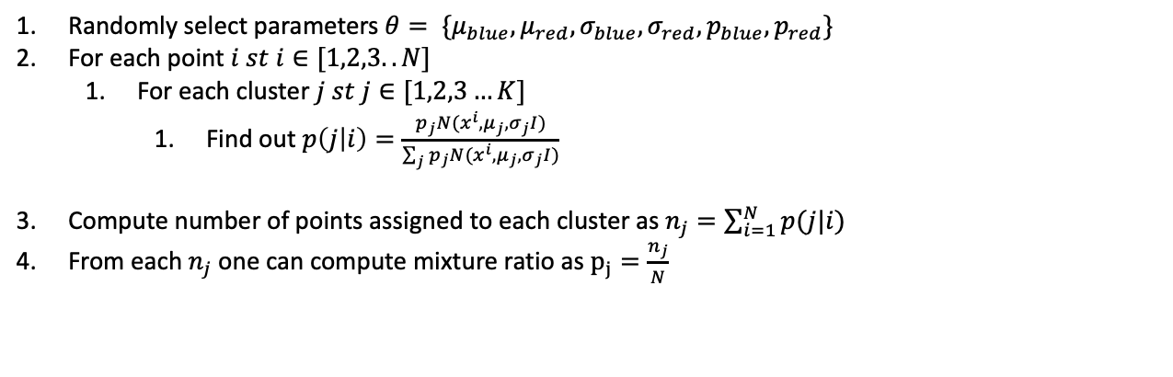
EM Algorithm: Overview
Randomly select parameters $θ= \{μ_{blue},μ_{red},σ_{blue},σ_{red}, p_{blue},p_{red}\}$
For each point $i st i∈[1,2,3..N]$
For each cluster $j st j∈[1,2,3…K]$
Find out $p\left(j | i\right)=\frac{p_{j}N(x^{i},μ_{j},σ_{j}I)}{\sum_{j}{p_{j}N(x^{i},μ_{j},σ_{j}I)}}$
Compute number of points assigned to each cluster as $n_{j}=\sum_{i=1}^{N}{p(j|i)}$
From each $n_{j}$one can compute mixture ratio as $p_{j}=\frac{n_{j}}{N}$
Randomly select parameters $θ= \{μ_{blue},μ_{red},σ_{blue},σ_{red}, p_{blue},p_{red}\}$
For each point $i st i∈[1,2,3..N]$
For each cluster $j st j∈[1,2,3…K]$
Find out $p\left(j | i\right)=\frac{p_{j}N(x^{i},μ_{j},σ_{j}I)}{\sum_{j}{p_{j}N(x^{i},μ_{j},σ_{j}I)}}$
E Step
v
v

Slide 21
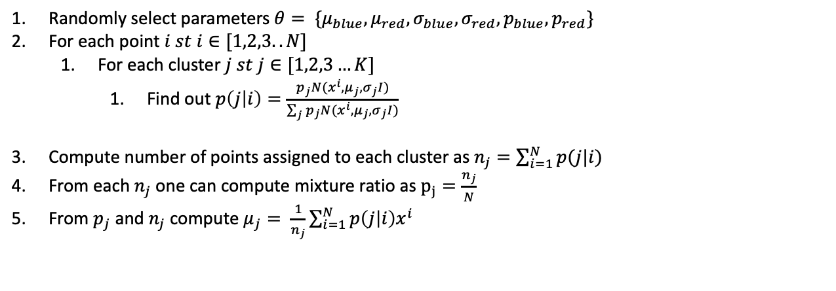
EM Algorithm: Overview
Randomly select parameters $θ= \{μ_{blue},μ_{red},σ_{blue},σ_{red}, p_{blue},p_{red}\}$
For each point $i st i∈[1,2,3..N]$
For each cluster $j st j∈[1,2,3…K]$
Find out $p\left(j | i\right)=\frac{p_{j}N(x^{i},μ_{j},σ_{j}I)}{\sum_{j}{p_{j}N(x^{i},μ_{j},σ_{j}I)}}$
Compute number of points assigned to each cluster as $n_{j}=\sum_{i=1}^{N}{p(j|i)}$
From each $n_{j}$one can compute mixture ratio as $p_{j}=\frac{n_{j}}{N}$
From $p_{j}$ and $n_{j}$ compute $μ_{j}= \frac{1}{n_{j}}\sum_{i=1}^{N}{p\left(j | i\right)x^{i}}$
Randomly select parameters $θ= \{μ_{blue},μ_{red},σ_{blue},σ_{red}, p_{blue},p_{red}\}$
For each point $i st i∈[1,2,3..N]$
For each cluster $j st j∈[1,2,3…K]$
Find out $p\left(j | i\right)=\frac{p_{j}N(x^{i},μ_{j},σ_{j}I)}{\sum_{j}{p_{j}N(x^{i},μ_{j},σ_{j}I)}}$
E Step
v
v

Slide 22
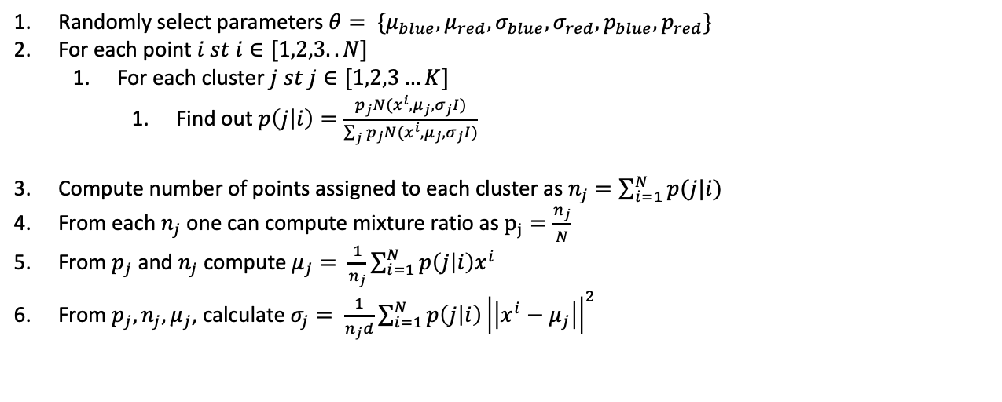
EM Algorithm: Overview
Randomly select parameters $θ= \{μ_{blue},μ_{red},σ_{blue},σ_{red}, p_{blue},p_{red}\}$
For each point $i st i∈[1,2,3..N]$
For each cluster $j st j∈[1,2,3…K]$
Find out $p\left(j | i\right)=\frac{p_{j}N(x^{i},μ_{j},σ_{j}I)}{\sum_{j}{p_{j}N(x^{i},μ_{j},σ_{j}I)}}$
Compute number of points assigned to each cluster as $n_{j}=\sum_{i=1}^{N}{p(j|i)}$
From each $n_{j}$one can compute mixture ratio as $p_{j}=\frac{n_{j}}{N}$
From $p_{j}$ and $n_{j}$ compute $μ_{j}= \frac{1}{n_{j}}\sum_{i=1}^{N}{p\left(j | i\right)x^{i}}$
From $p_{j}, n_{j}, μ_{j}$, calculate $σ_{j}= \frac{1}{n_{j}d}\sum_{i=1}^{N}{p\left(j | i\right){\left|\left|x^{i}−μ_{j}\right|\right|}^{2}}$
Randomly select parameters $θ= \{μ_{blue},μ_{red},σ_{blue},σ_{red}, p_{blue},p_{red}\}$
For each point $i st i∈[1,2,3..N]$
For each cluster $j st j∈[1,2,3…K]$
Find out $p\left(j | i\right)=\frac{p_{j}N(x^{i},μ_{j},σ_{j}I)}{\sum_{j}{p_{j}N(x^{i},μ_{j},σ_{j}I)}}$
E Step
v
v

Slide 23
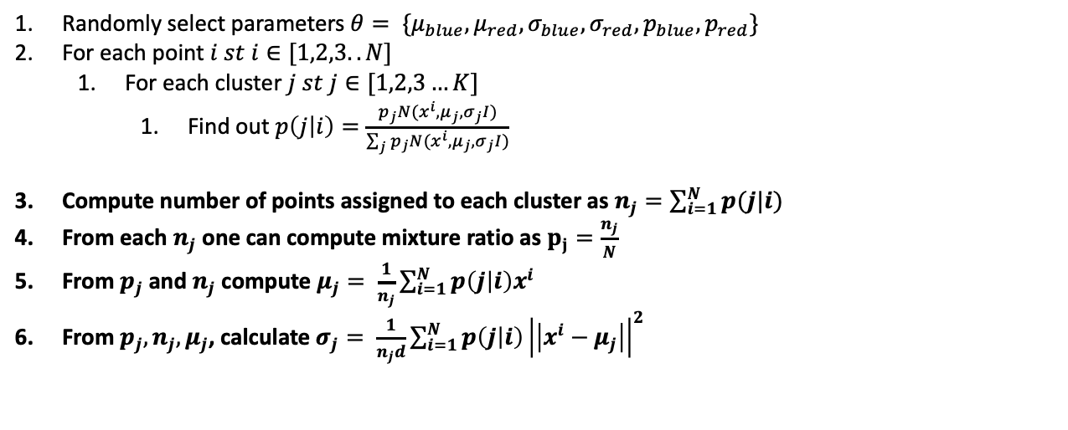
EM Algorithm: Overview
Randomly select parameters $θ= \{μ_{blue},μ_{red},σ_{blue},σ_{red}, p_{blue},p_{red}\}$
For each point $i st i∈[1,2,3..N]$
For each cluster $j st j∈[1,2,3…K]$
Find out $p\left(j | i\right)=\frac{p_{j}N(x^{i},μ_{j},σ_{j}I)}{\sum_{j}{p_{j}N(x^{i},μ_{j},σ_{j}I)}}$
Compute number of points assigned to each cluster as $n_{j}=\sum_{i=1}^{N}{p(j|i)}$
From each $n_{j}$one can compute mixture ratio as $p_{j}=\frac{n_{j}}{N}$
From $p_{j}$ and $n_{j}$ compute $μ_{j}= \frac{1}{n_{j}}\sum_{i=1}^{N}{p\left(j | i\right)x^{i}}$
From $p_{j}, n_{j}, μ_{j}$, calculate $σ_{j}= \frac{1}{n_{j}d}\sum_{i=1}^{N}{p\left(j | i\right){\left|\left|x^{i}−μ_{j}\right|\right|}^{2}}$
v
v
M Step

Slide 24
EM Algorithm: Overview
Randomly select parameters $θ= \{μ_{blue},μ_{red},σ_{blue},σ_{red}, p_{blue},p_{red}\}$
For each point $i st i∈[1,2,3..N]$
For each cluster $j st j∈[1,2,3…K]$
Find out $p\left(j | i\right)=\frac{p_{j}N(x^{i},μ_{j},σ_{j}I)}{\sum_{j}{p_{j}N(x^{i},μ_{j},σ_{j}I)}}$
Compute number of points assigned to each cluster as $n_{j}=\sum_{i=1}^{N}{p(j|i)}$
From each $n_{j}$one can compute mixture ratio as $p_{j}=\frac{n_{j}}{N}$
From $p_{j}$ and $n_{j}$ compute $μ_{j}= \frac{1}{n_{j}}\sum_{i=1}^{N}{p\left(j | i\right)x^{i}}$
From $p_{j}, n_{j}, μ_{j}$, calculate $σ_{j}= \frac{1}{n_{j}d}\sum_{i=1}^{N}{p\left(j | i\right){\left|\left|x^{i}−μ_{j}\right|\right|}^{2}}$
E Step
v
v
M Step
Repeat E and M Steps alternately till convergence*. (Very little change in parameter values or log likelihood from one iteration to another)

Slide 25
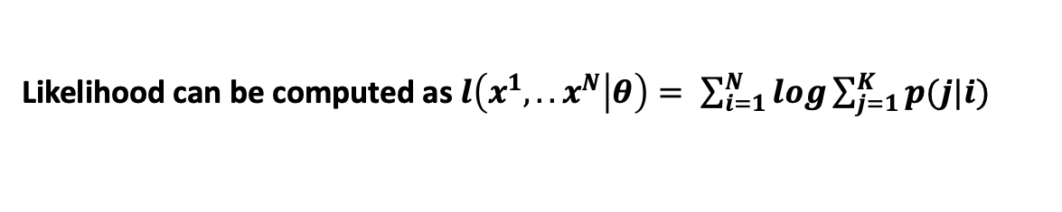
EM Algorithm: Overview
Randomly select parameters $θ= \{μ_{blue},μ_{red},σ_{blue},σ_{red}, p_{blue},p_{red}\}$
For each point $i st i∈[1,2,3..N]$
For each cluster $j st j∈[1,2,3…K]$
Find out $p\left(j | i\right)=\frac{p_{j}N(x^{i},μ_{j},σ_{j}I)}{\sum_{j}{p_{j}N(x^{i},μ_{j},σ_{j}I)}}$
Compute number of points assigned to each cluster as $n_{j}=\sum_{i=1}^{N}{p(j|i)}$
From each $n_{j}$one can compute mixture ratio as $p_{j}=\frac{n_{j}}{N}$
From $p_{j}$ and $n_{j}$ compute $μ_{j}= \frac{1}{n_{j}}\sum_{i=1}^{N}{p\left(j | i\right)x^{i}}$
From $p_{j}, n_{j}, μ_{j}$, calculate $σ_{j}= \frac{1}{n_{j}d}\sum_{i=1}^{N}{p\left(j | i\right){\left|\left|x^{i}−μ_{j}\right|\right|}^{2}}$
E Step
v
v
M Step
Repeat E and M Steps alternately till convergence*. (Very little change in parameter values or log likelihood from one iteration to another)
Likelihood can be computed as$l\left(x^{1},..x^{N} | θ\right)= \sum_{i=1}^{N}{log\sum_{j=1}^{K}{p(j|i)}}$

